Slide 1
CS 321-Design & Analysis of Algorithms
Lecture 02
Instructor: Asim Rehan
arehan@numl.edu.pk
National University of Modern Languages, Islamabad

Slide 2
Recursion
Basic problem solving technique is to divide a problem into smaller subproblems
These subproblems may also be divided into smaller subproblems
When the subproblems are small enough to solve directly the process stops
A recursive algorithm is a problem solution that has been expressed in terms of two or more easier to solve subproblems

Slide 3
What is recursion?
A procedure that is defined in terms of itself
In a computer language a function that calls itself

Slide 4
Recursion
A recursive definition is one which is defined in terms of itself.
Examples:
A phrase is a "palindrome" if the 1st and last letters are the same, and what's inside is itself a palindrome (or empty or a single letter)
Rotor
Rotator
12344321

Slide 5
Recursion
The definition of the natural numbers:
1 is a natural number
if n is a natural number, then n+1 is a natural number
N =

Slide 6
Recursion in Computer Science
1. Recursive data structure: A data structure that is partially composed of smaller or simpler instances of the same data structure.
For instance, a tree is composed of smaller trees (subtrees) and leaf nodes, and a list may have other lists as elements.
a data structure may contain a pointer to a variable of the same type:
struct Node {
int data;
Node *next;
};

Slide 7
Recursive procedure: a procedure that invokes itself
Recursive definitions: if A and B are postfix expressions, then A B + is a postfix expression.

Slide 8
Recursive Data Structures
Linked lists and trees are recursive data structures:
struct Node {
int data;
Node *next;
};
struct TreeNode {
int data;
TreeNode *left;
TreeNode * right;
};
Recursive data structures suggest recursive algorithms.

Slide 9
A mathematical look
We are familiar with
f(x) = 3x+5
How about
f(x) = 3x+5 if x > 10 or
f(x) = f(x+2) -3 otherwise

Slide 10
Calculate f(5)
f(x) = 3x+5 if x > 10 or
f(x) = f(x+2) -3 otherwise
f(5) = f(7)-3
f(7) = f(9)-3
f(9) = f(11)-3
f(11) = 3(11)+5
= 38
But we have not determined what f(5) is yet!

Slide 11
Calculate f(5)
f(x) = 3x+5 if x > 10 or
f(x) = f(x+2) -3 otherwise
f(5) = f(7)-3 = 29
f(7) = f(9)-3 = 32
f(9) = f(11)-3 = 35
f(11) = 3(11)+5
= 38
Working backwards we see that f(5)=29

Slide 12
Series of calls
f(5)
f(7)
f(9)
f(11)

Slide 13
Recursion
Recursion occurs when a function/procedure calls itself.
Many algorithms can be best described in terms of recursion.
Example: Factorial function
The product of the positive integers from 1 to n inclusive is
called "n factorial", usually denoted by n!:
n! = 1 * 2 * 3 .... (n-2) * (n-1) * n

Slide 14
Recursive Definition of the Factorial Function
1, if n = 0
n * (n-1)! if n > 0
n! =
5! = 5 * 4!
4! = 4 * 3!
3! = 3 * 2!
2! = 2 * 1!
1! = 1 * 0!
= 5 * 24 = 120
= 4 * 3! = 4 * 6 = 24
= 3 * 2! = 3 * 2 = 6
= 2 * 1! = 2 * 1 = 2
= 1 * 0! = 1

Slide 15
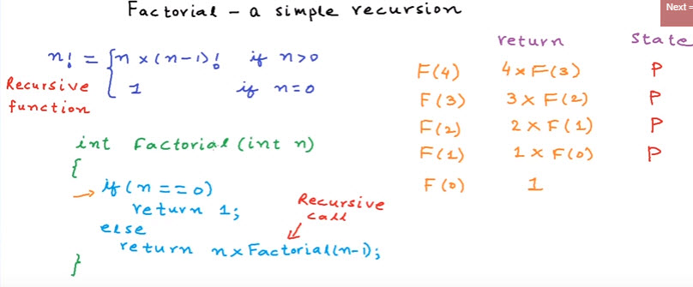

Slide 16
Recursive Definition of the Fibonacci Sequence
The Fibonacci numbers are a series of numbers as follows:
fib(1) = 1
fib(2) = 1
fib(3) = 2
fib(4) = 3
fib(5) = 5
...
fib(n) =
1, n <= 2
fib(n-1) + fib(n-2), n > 2
fib(3) = 1 + 1 = 2
fib(4) = 2 + 1 = 3
fib(5) = 2 + 3 = 5

Slide 17
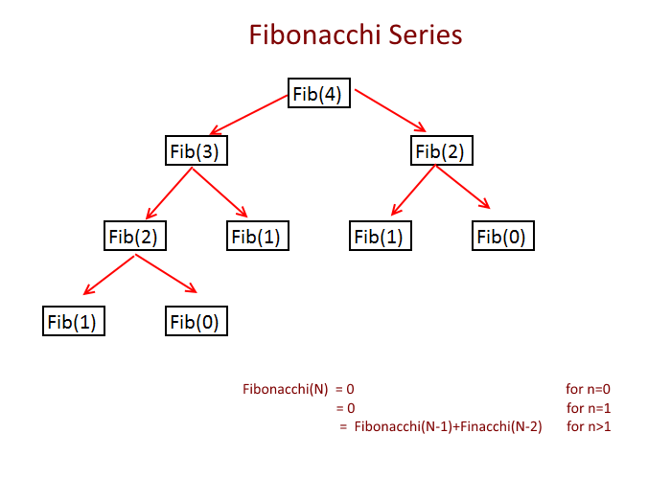

Slide 18
iterative
int main()
{
int n=5, firstTerm = 1, secondTerm = 1, nextTerm;
for (int i = 1; i <= n-2; ++i)
{ nextTerm = firstTerm + secondTerm;
cout << nextTerm << " + ";
firstTerm = secondTerm;
secondTerm = nextTerm;
}
return 0; }

Slide 19
Recursive Definition
int BadFactorial(n){
int x = BadFactorial(n-1);
if (n == 1)
return 1;
else
return n*x;
}
What is the value of BadFactorial(2)?
We must make sure that recursion eventually stops, otherwise
it runs forever:

Slide 20
Using Recursion Properly
For correct recursion we need two parts:
1. One (ore more) base cases that are not recursive, i.e. we
can directly give a solution:
if (n==1)
return 1;
2. One (or more) recursive cases that operate on smaller
problems that get closer to the base case(s)
return n * factorial(n-1);
The base case(s) should always be checked before the recursive calls.

Slide 21
Counting Digits
Recursive definition
digits(n) = 1 if (–9 <= n <= 9)
1 + digits(n/10) otherwise
Example
digits(321) =
1 + digits(321/10) = 1 +digits(32) =
1 + [1 + digits(32/10)] = 1 + [1 + digits(3)] =
1 + [1 + (1)] =
3

Slide 22
Counting Digits in C++
int numberofDigits(int n) {
if ((-10 < n) && (n < 10))
return 1
else
return 1 + numberofDigits(n/10);
}

Slide 23
Recursion
If you want to compute f(x) but can’t compute it directly
Assume you can compute f(y) for any value of y smaller than x
Use f(y) to compute f(x)
For this to work, there has to be at least one value of x for which f(x) can be computed directly (e.g. these are called base cases)

Slide 24
Evaluating Exponents Recurisivley
int power(int k, int n) {
// raise k to the power n
if (n == 0)
return 1;
else
return k * power(k, n – 1);
}
Notes:
2^3 = 8
----------------
2 * n-1
2 * n-1
2 * n-1=0

Slide 25
Divide and Conquer
Using this method each recursive subproblem is about one-half the size of the original problem
If we could define power so that each subproblem was based on computing k^{n/2} instead of k^{n – 1} we could use the divide and conquer principle
Recursive divide and conquer algorithms are often more efficient than iterative algorithms

Slide 26
Evaluating Exponents Using Divide and Conquer
int power(int k, int n) {
// raise k to the power n
if (n == 0)
return 1;
else{
int t = power(k, n/2);
if ((n % 2) == 0)
return t * t;
else
return k * t * t;
}

Slide 27
Stacks
Every recursive function can be implemented using a stack and iteration.
Every iterative function which uses a stack can be implemented using recursion.

Slide 28
Disadvantages
May run slower.
Compilers
Inefficient Code
May use more space.

Slide 29
Advantages
More natural.
Easier to prove correct.
Easier to analysis.
More flexible.

Slide 30
Reference
Introduction to Algorithms
Chapter # 4
Thomas H. Cormen
3rd Edition

